Slide 1








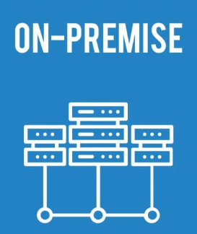

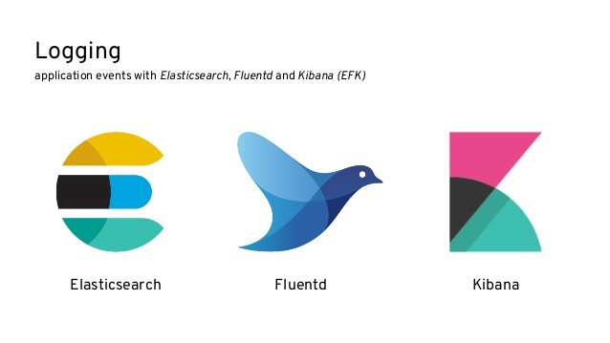


OpenShift 4.x Network Architecture – Azure IPI
Virtual Network
Express Route
Subnet – Worker/Infra
Azure DNS Zone
On-prem-domain.com
Public IP Address
Public
App Load balancer
:22627
Worker Nodes
AZ 1,2,3
Peered with Hub
Virtual Network
Express Route
5 Gbps
A record
Private ingress
Monitoring
*apps.<cluster>.basedomain.com
EFK
Internal App Load balancer :80, :443
NSG - allow 22627
Subnet - Master
Public IP Address
Public
API Load balancer
disabled
Master Nodes
AZ 1,2,3
https/6443
A record
Private ingress
Jump Server
api.<cluster>.basedomain.com
Internal API Load balancer :6443, :22623
Backup Server
Azure DNS Zone
<cluster>.basedomain.com
Storage account
Fileshare - Image registry
NSG – allow 6443

Slide 2













OpenShift 4.x Network Architecture - Azure IPI – Enterprise
External Cloud - SaaS
Virtual Network
Express Route
Subnet – Worker/Infra
Azure DNS Zone
On-prem-domain.com
https/443
Public IP Address
Public
App Load balancer
:22627
Worker Nodes
AZ 1,2,3
Peered with Hub
Virtual Network
Express Route
A record
Private ingress
Monitoring
Creates Service Now incident
*apps.<cluster>.basedomain.com
EFK
Internal App Load balancer :80, :443
https/8088
NSG - allow 22627
UDP /514
Subnet - Master
TCP/587
TCP/8082
TCP/443
SMTP server
Public IP Address
Public
API Load balancer
disabled
Master Nodes
AZ 1,2,3
https/6443
Mail alerts
OCP platform team
TrueSight mail box
A record
Private ingress
Jump Server
TCP / 389
api.<cluster>.basedomain.com
Internal API Load balancer :6443, :22623
Backup Server
Azure DNS Zone
<cluster>.basedomain.com
https/6443
TCP / 1556,13724, 13783
Storage account
Fileshare - Image registry
NSG – allow 6443
https/6443

Slide 4
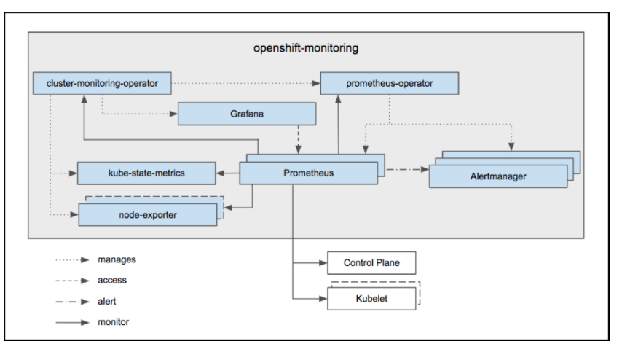

Slide 5

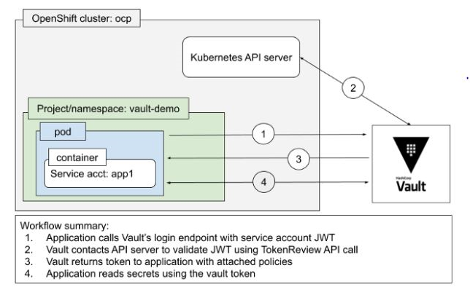

Slide 6
Virtual Network
Subnet - Worker
A record
*apps.<cluster>.basedomain.com
Public ingress
Public IP Address
Public
App Load balancer
:22627
Worker Nodes
AZ 1,2,3
A record
*apps.<cluster>.basedomain.com
Private ingress
Internal App Load balancer :80, :443
NSG - 22627
Virtual Network
Peered with Hub
Subnet - Master
Express Route
5 Gbps
Public IP Address
Public
API Load balancer
disabled
Master Nodes
AZ 1,2,3
Jump Server
A record
api.<cluster>.basedomain.com
Internal API Load balancer :6443, :22623
Backup Server
Azure DNS Zone
<cluster>.basedomain.com
NSG – allow 6443

Slide 7
Virtual Network
Subnet – Worker/Infra
A record
*apps.<cluster>.basedomain.com
Public ingress
Public IP Address
Public
App Load balancer
:22627
Worker/Infra Nodes
AZ 1,2,3
A record
*apps.<cluster>.basedomain.com
Private ingress
Internal App Load balancer :80, :443
Virtual Network
Peered with Hub
Express Route
5 Gbps
NSG - 22627
Subnet - Master
Public IP Address
Public
API Load balancer
disabled
Master Nodes
AZ 1,2,3
Jump Server
Storage account
Files - Image registry
A record
api.<cluster>.basedomain.com
Internal API Load balancer :6443, :22623
Backup Server
Azure DNS Zone
<cluster>.basedomain.com
NSG – allow 6443

Slide 8
OpenShift 4.x Network Architecture – Azure IPI
Virtual Network
Express Route
Subnet – Worker/Infra
A record
Public ingress
*apps.<cluster>.basedomain.com
Public IP Address
Public
App Load balancer
:22627
Worker Nodes
AZ 1,2,3
Peered with Hub
Virtual Network
Express Route
5 Gbps
A record
Private ingress
Monitoring
*apps.<cluster>.basedomain.com
EFK
Internal App Load balancer :80, :443
NSG - allow 22627
Subnet - Master
Public IP Address
Public
API Load balancer
disabled
Master Nodes
AZ 1,2,3
https/6443
A record
Private ingress
Jump Server
api.<cluster>.basedomain.com
Internal API Load balancer :6443, :22623
Backup Server
Azure DNS Zone
<cluster>.basedomain.com
Storage account
Fileshare - Image registry
NSG – allow 6443

Slide 9
OpenShift 4.x Network Architecture - Azure IPI – Enterprise
External Cloud - SaaS
Virtual Network
Express Route
Subnet – Worker/Infra
A record
Public ingress
https/443
*apps.<cluster>.basedomain.com
Public IP Address
Public
App Load balancer
:22627
Worker Nodes
AZ 1,2,3
Peered with Hub
Virtual Network
Express Route
5 Gbps
A record
Private ingress
Monitoring
Creates Service Now incident
*apps.<cluster>.basedomain.com
EFK
Internal App Load balancer :80, :443
https/8088
NSG - allow 22627
UDP /514
Subnet - Master
TCP/587
TCP/8082
TCP/443
Public IP Address
Public
API Load balancer
disabled
Master Nodes
AZ 1,2,3
Mail alerts
OCP platform team
TrueSight mail box
https/6443
A record
Private ingress
Jump Server
TCP / 389
api.<cluster>.basedomain.com
Internal API Load balancer :6443, :22623
Backup Server
Azure DNS Zone
<cluster>.basedomain.com
https/6443
TCP / 1556,13724, 13783
Storage account
Fileshare - Image registry
NSG – allow 6443

